Slide 1
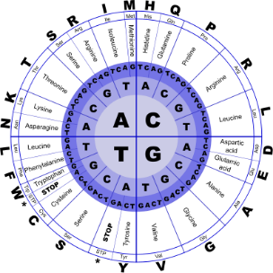
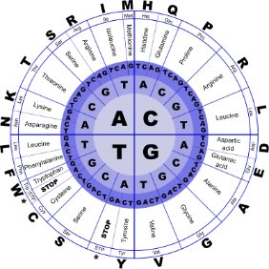
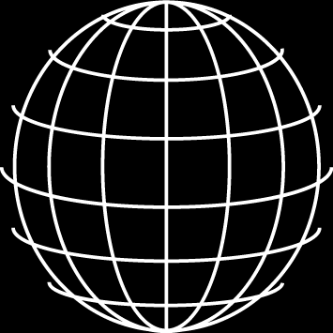

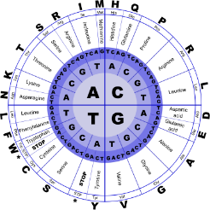
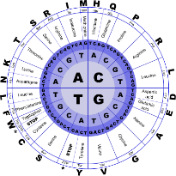
Fundamentals of Programming II
Stacks Queues

Slide 2
Introduction to the Stack ADTand Queues
Stack: a LIFO (last in, first out) data structure
Examples:
  plates in a cafeteria serving area
  return addresses for function calls

Slide 3
Stack Basics
Stack is usually implemented as a list, with additions and removals taking place at one end of the list
The active end of the list implementing the stack is the top of the stack
Stack types:
  Static – fixed size, often implemented using an array
  Dynamic – size varies as needed, often implemented using a linked list

Slide 4
Stack Operations and Functions
Operations:
  push: add a value at the top of the stack
  pop: remove a value from the top of the stack
Functions:
  isEmpty: true if the stack currently contains no elements
  isFull: true if the stack is full; only useful for static stacks

Slide 5
Dynamic Stacks
Implemented as a linked list
Can grow and shrink as necessary
Can't ever be full as long as memory is available

Slide 6
Introduction to the Queue ADT
Queue: a FIFO (first in, first out) data structure.
Examples:
  people in line at the theatre box office
  print requests sent by users to a network printer
Implementation:
  static: fixed size, implemented as array
  dynamic: variable size, implemented as linked list

Slide 7
Queue Locations and Operations
rear: position where elements are added
front: position from which elements are removed
enqueue: add an element to the rear of the queue
dequeue: remove an element from the front of a queue

Slide 8
Array Implementation of Queue
An empty queue that can hold char values:
enqueue('E');
front,
rear
E
front
rear

